Slide 1
CAPSTONE PROJECT : SPORTS DATA ANALYSIS (OLYMPIC DATASET

Slide 2
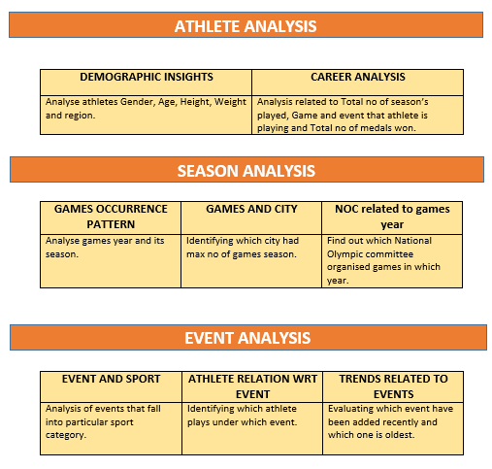
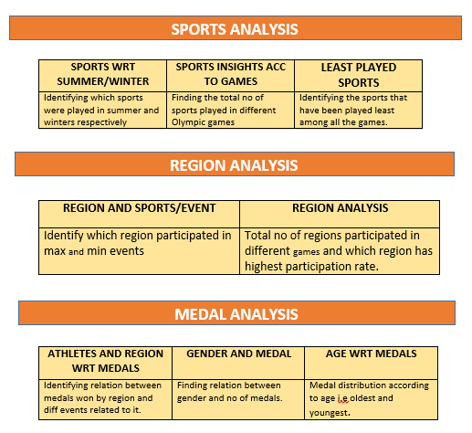
MECE FRAMEWORK

Slide 3
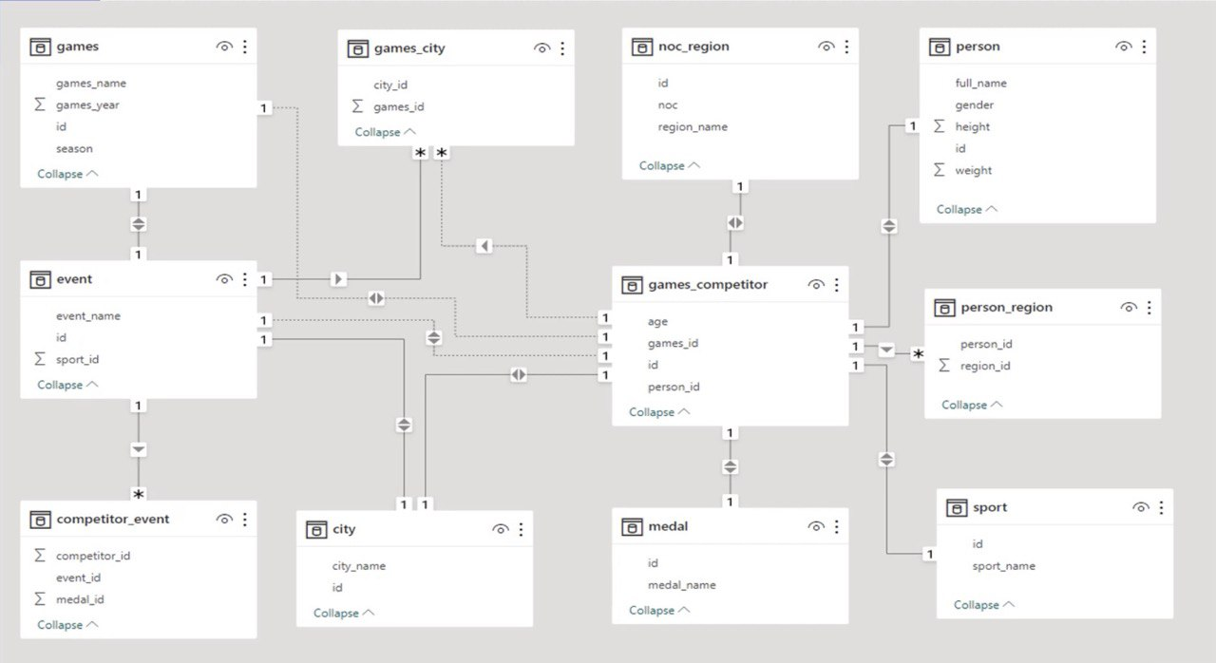
ER DIAGRAM

Slide 4
POWER BI QUESTIONS

Slide 5
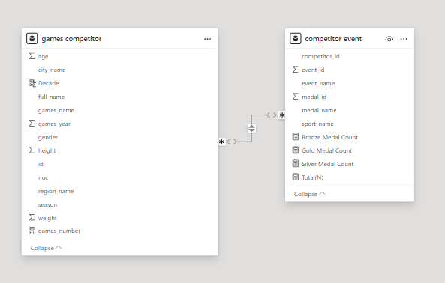
MERGED TABLE AND NEW RELATIONSHIP

Slide 6
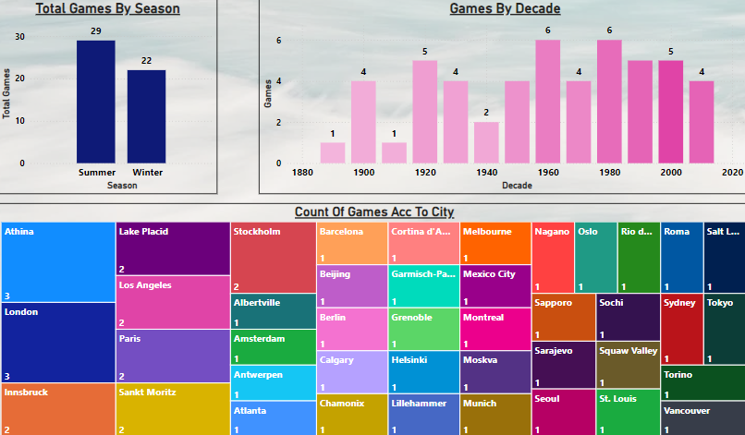
GAMES ANALYSIS

Slide 7
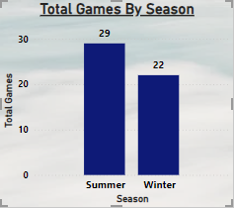
How many Olympic Games have been held in each season (Summer vs. Winter)?
ANALYSIS SUMMARY
Gleaning from the visualization total games season of Olympic have taken place more in summer rather than in winter.

Slide 8
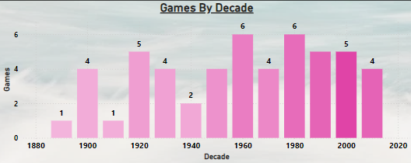
What is the distribution of games across different decades?
ANALYSIS SUMMARY
GLEANING FROM THE VISUALIZATION MAX NO OF GAMES HAVE TAKEN PLACE IN 60’S AND 80’S AND MIN NO OF GAMES WERE IN 1890’S AND 1910’S BUT ONE CAN SAY THERE WAS ALMOST CONSISTENCY IN GAMES AFTER 1960’S.

Slide 9
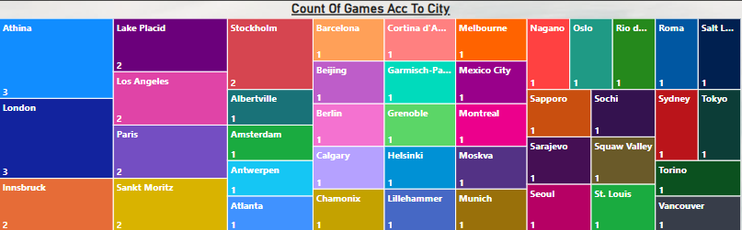
Which cities have hosted the most Olympic Games?
SUMMARY ANALYSIS
GLEANING FROM THE VISUAL ATHINA,LONDON AND INNSBRUCK HAVE HOSTED GAMES THRICE WHEREAS MAX NO OF CITIES HAVE HOSTED GAMES ONLY ONCE.

Slide 10
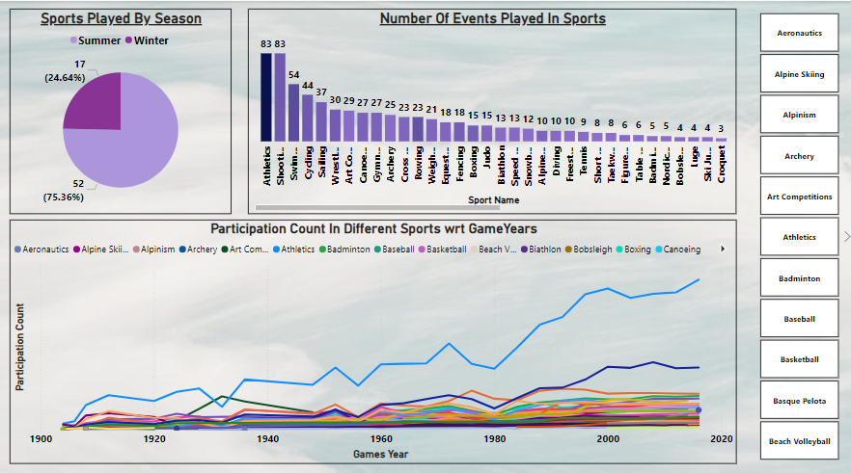
SPORTS ANALYSIS

Slide 11
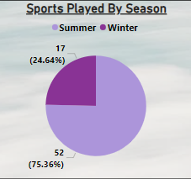
What is the distribution of sports between Summer and Winter Olympics?
SUMMARY ANALYSIS
GLEANING FROM VISUAL TOTAL THERE ARE 2 SEASON FOR OLYMPIC GAMES AND IN SUMMER SEASON MAX NO OF SPORTS ARE PLAYED I.E 52 AND IN WINTER ONLY 17 SPORTS ARE PLAYED.

Slide 12
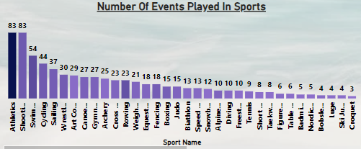
Which sports have the highest number of events in the Olympics?
SUMMARY ANALYSIS
GLEANING FROM VISUAL EVERY SPORT HAVE DIFFERENT NO OF EVENTS AND ATHLETICS/SHOOTING HAVE MAX NO OF EVENTS I.E 83 AND AFTER THAT SECOND HIGHEST IS SHOOTING.

Slide 13
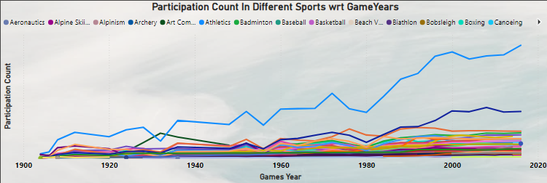
How has the participation in each sport evolved over time?
SUMMARY ANALYSIS
GLEANING FROM VISUALISATION PARTICIPATION COUNT IN DIFFERENT SPORTS HAVE BEEN INCREASING WITH TIME AND THE GRAPH OF ATHLETICS PARTICIPATION IS QUITE PROGRESSIVE IN COMPARISION TO OTHER SPORTS.

Slide 14
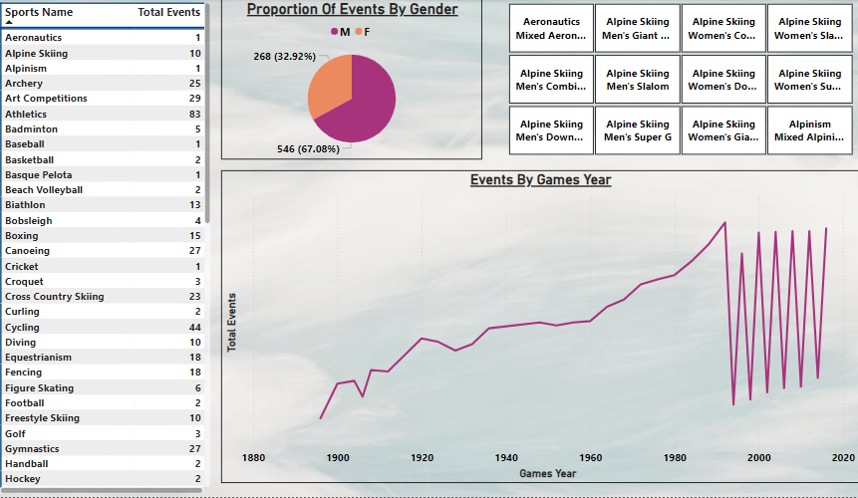
EVENT ANALYSIS

Slide 15
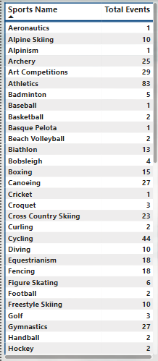
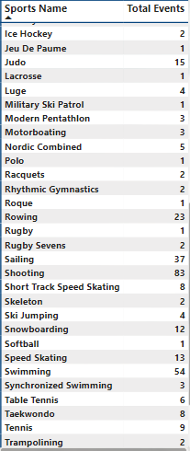
How many events are there in each sport?
SUMMARY ANALYSIS
FOR REPRESENTING NO OF EVENTS IN EACH SPORT TABLE HAS BEEN USED AS IT BECOME QUITE EASY TO ANALYSE THE NUMBERS.ATHLETICS AND SHOOTING SPORT HAVE MAX NO OF EVENTS AND SPORTS SUCH AS ALPHINISM,BASQUE PELOTA,CRICKET,LACROSSE,POLO,ROQUE,RUGBY AND SOFTBALL HAVE SINGLE EVENT ONLY.

Slide 16
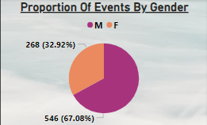
What is the distribution of events by gender (Men, Women, Mixed)?
SUMMARY ANALYSIS
GLEANING FROM VISUALIZATION MAJORITY OF EVENTS ARE PLAYED BY MEN AND IT’S PROPORTION TO FEMALE COMES OUT TO 67.08 % WHERE AS FEMALE PLAYS 32.92% OF EVENTS IN RESPECTIVE SPORTS.

Slide 17
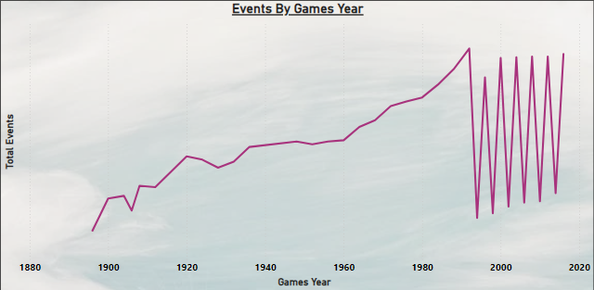
How has the number of events changed over time?
SUMMARY ANALYSIS
TOTAL NO OF EVENTS FOR PARTICULAR GAMES DEPEND ON THE GAMES SEASON I.E SUMMER OR WINTER AND IN WINTER SEASON NO OF EVENTS ARE QUITE LOW AS FEW NO OF GAMES ARE BEING PLAYED WRT SUMMER SEASON.

Slide 18
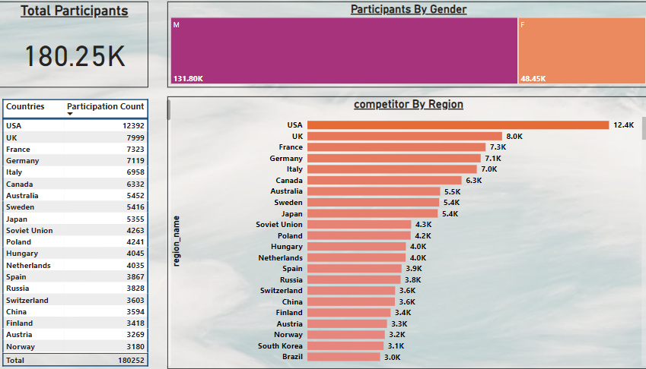
PARTICIPANT ANALYSIS

Slide 19
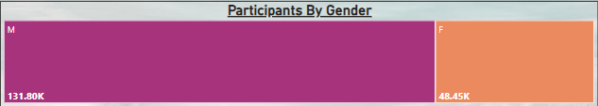
What is the distribution of participants by gender?
SUMMARY ANALYSIS
TREE MAP VISUAL PROVIDES NO OF PARTICIPANT BY GENDER AND MALE HAVE AROUND 132K AND FEAMLE HAVE 48K PARTICIPANT SO BASICALLY MALE ARE 2.5 TIMES OF FEMALE PARTICIPANTS

Slide 20
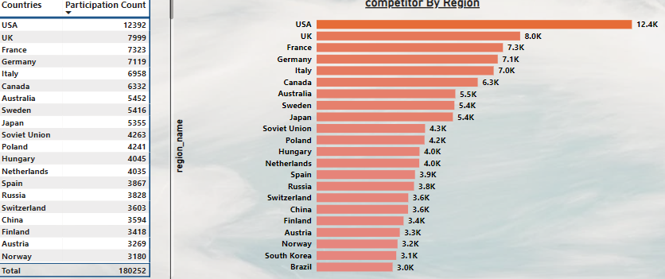
Which countries have the highest number of participants in the Olympics?
SUMMARY ANALYSIS
GLEANING FROM THE BAR GRAPH AND TABLE USA HAVE MAX NO OF PARTICIPANTS I.E 12392 AND AFTER THAT UK HAVE 8K.

Slide 21
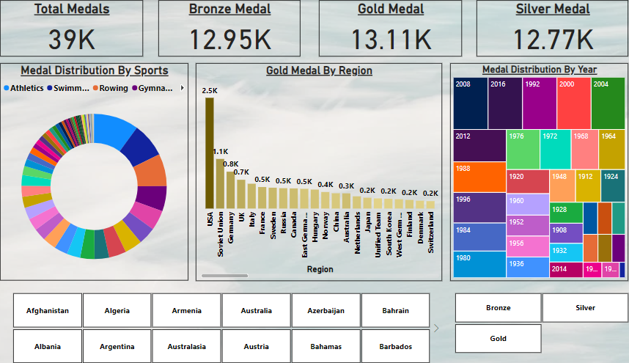
MEDAL ANALYSIS

Slide 22
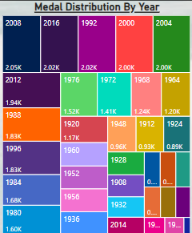
How many medals have been awarded in each Olympics?
SUMMARY ANALYSIS
GLEANING FROM THE VISUAL MEDALS DISTRIBUTION IN EACH OLYPMPIC GAME IS AROUND 2K

Slide 23
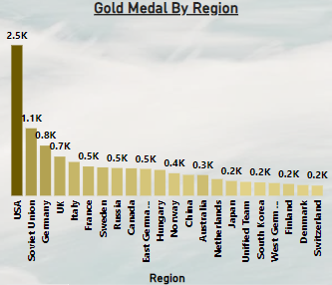
Which countries have the highest number of gold medals?
SUMMARY ANALYSIS
GLEANING FROM THE VISUALISATION MAX NO OF GOLD MEDAL HAVE BEEN BAGGED BY USA WHICH COUNT TO AROUND 2.5K AND AFTER THAT SOVIET UNION IS ON SECOND PLACE IN GOLD MEDAL TALLY WITH 1.1 K

Slide 24
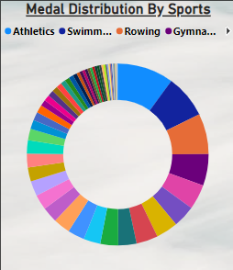
How does the medal distribution vary across different sports?
SUMMARY ANALYSIS
GLEANING FROM THE VISUALISATION ATHLETICS HAVE MAX NO OF MEDAL AROUND 3.9K AND HAVING SHARE OF 10% OF TOTAL MEDAL DISTRIBUTION ON THE OTHER HAND SWIMMING HAVE AROUND 7.7% SHARE.

Slide 25
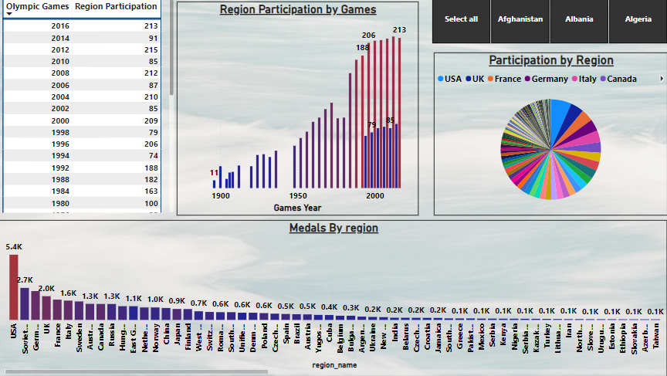
REGION ANALYSIS

Slide 26
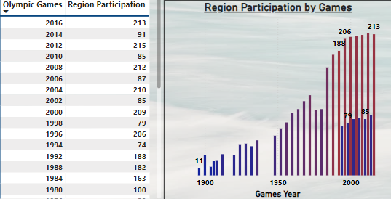
How many regions or NOCs participate in each Olympic Games?
SUMMARY ANALYSIS
AS OLYMPIC MAIN EVENT TAKE PLACE AFTER EVERY 4 YEAR SO MAX PARTICIPATION BY VARIOUS REGION CAN BE SEEN IN THAT WITH 2016 EVENT HAVING 213 REGION AS PARTICIPANTS

Slide 27
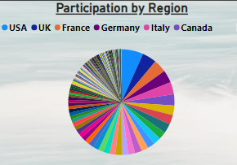
Which regions have the highest number of participants in the Olympics?
SUMMARY ANALYSIS
GLEANING FROM THE VISUAL USA HAVE MAX NO OF PARTICIPANTS AND REGIONS LIKE BENIN,HAITI,CONGO HAVE ONE OF THE LEAST PARTICIPATION IN GAMES.

Slide 28
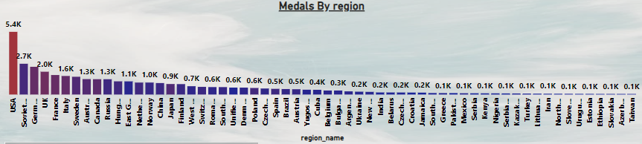
What is the distribution of medals among different regions?
SUMMARY ANALYSIS
GLEANING FROM THE VISUAL USA HAVE MAX NO OF MEDAL AMONG ALL THE REGION FOLLOWED BY SOVIET UNION.

Slide 29
EDA QUESTIONS

Slide 30
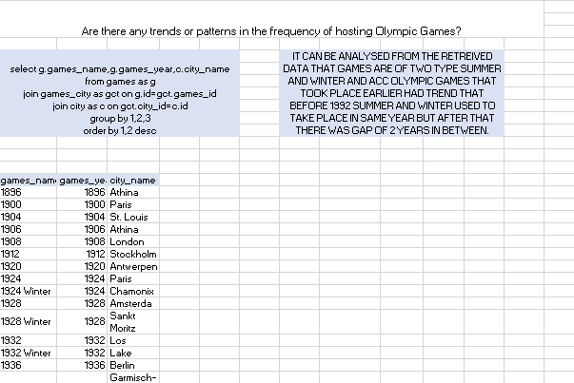

Slide 31
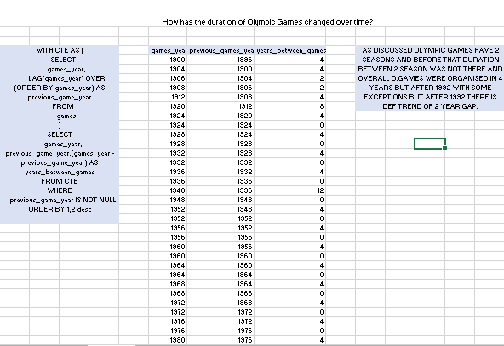

Slide 32
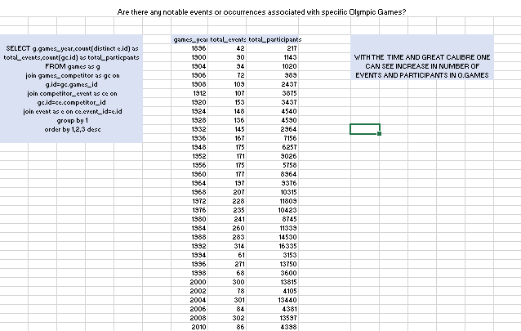

Slide 33
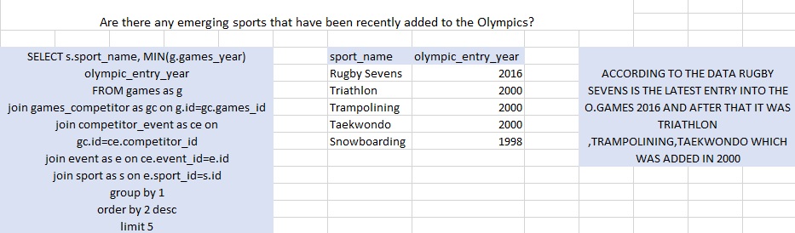

Slide 34
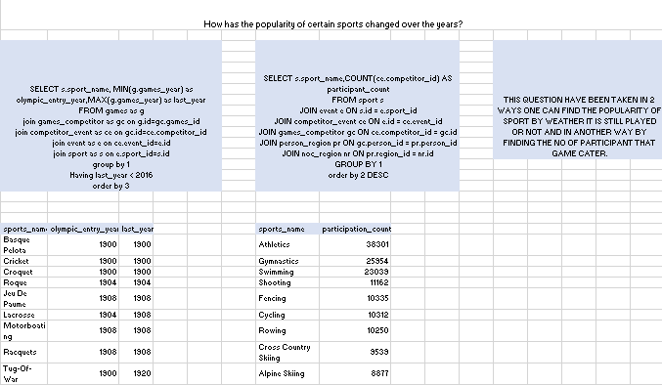

Slide 35
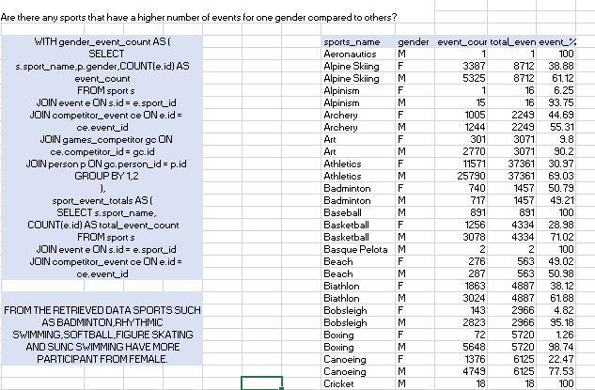

Slide 36
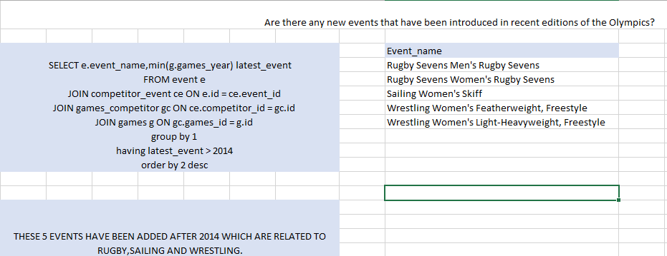

Slide 37
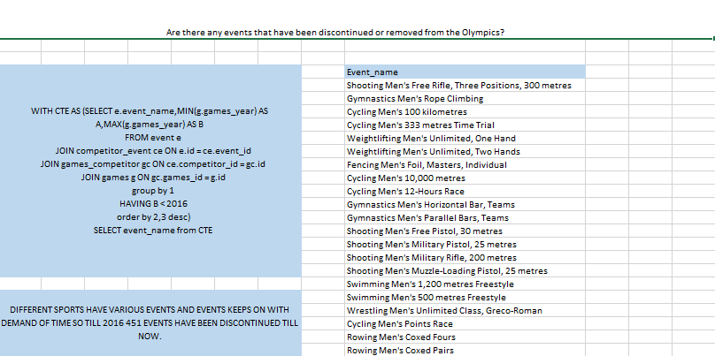

Slide 38
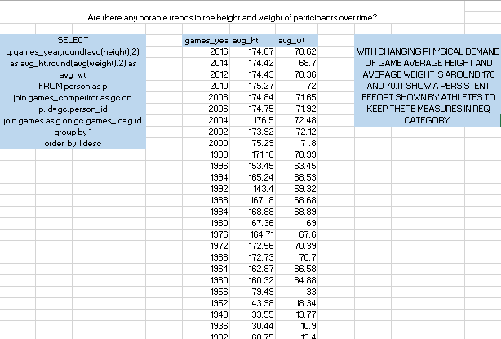

Slide 39
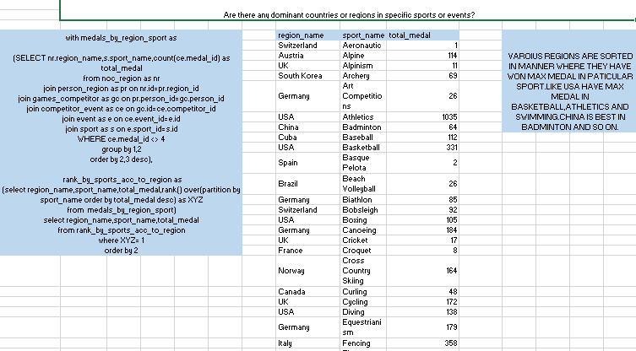

Slide 40
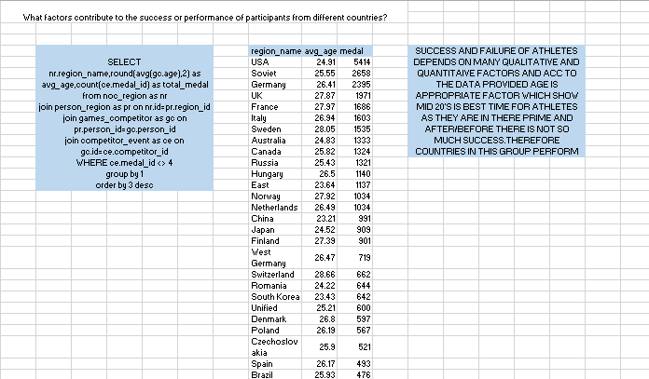

Slide 41
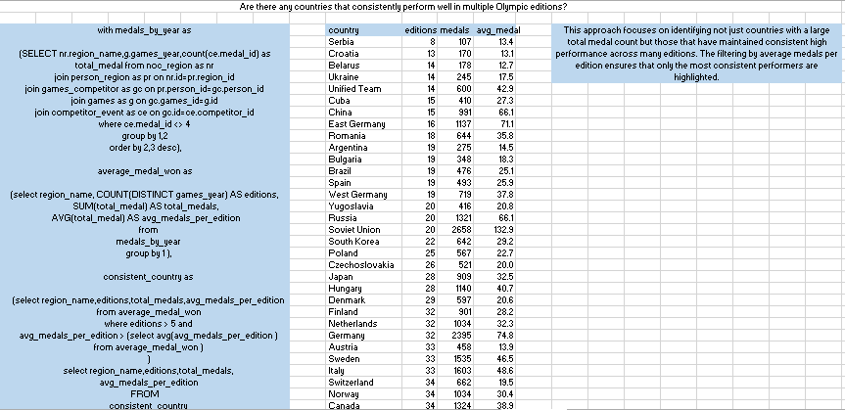

Slide 42
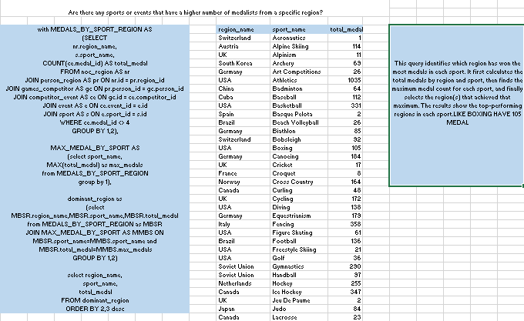

Slide 43
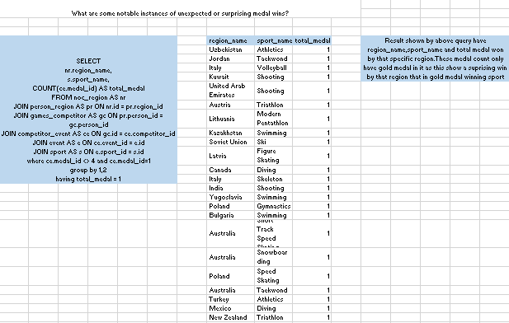

Slide 44
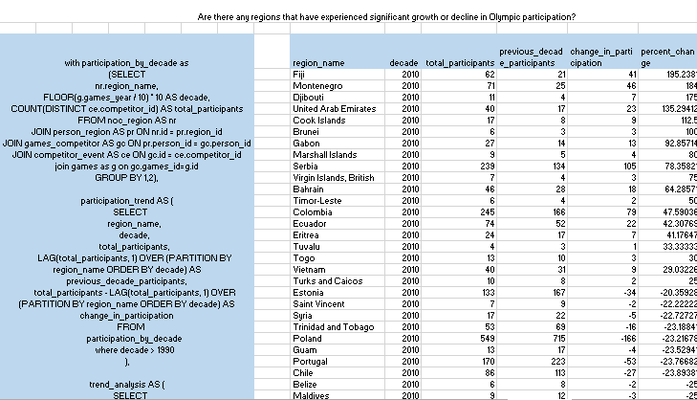
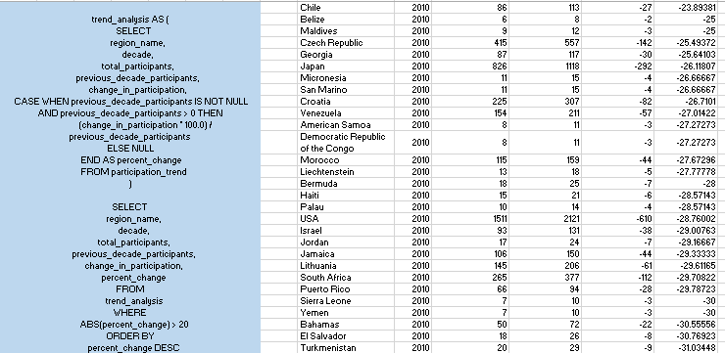

Slide 45
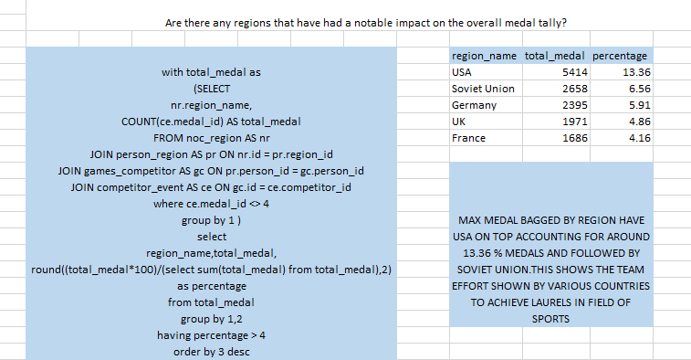

Slide 46
THANK YOU

